Slide 1
Sentiment Analysis on Mentors Feedback using RNN
Sheikh Md. Faysal
Data Scientist at DSL

Slide 2
Outline
Why Recurrent Neural Networks (RNNs)?
Word Embeddings
The Vanilla RNN unit
Sentiment Classification using RNN
Drawbacks of RNN
GRU

Slide 3
Recurrent Neural Networks (RNNs)
Recurrent Neural Networks take the previous output or hidden states as inputs. The composite input at time t has some historical information about the happenings at time T < t
RNNs are useful as their intermediate values (state) can store information about past inputs for a time that is not fixed a priori

Slide 4


Word Embeddings
Continuous Bag of Words (CBOW)- Predict center word from (bag of) context words
Skip-grams- Predict context (”outside”) words (position independent) given center word
Glove : Co-occurrence statistics in a form of word co occurrence matrix X

Slide 5
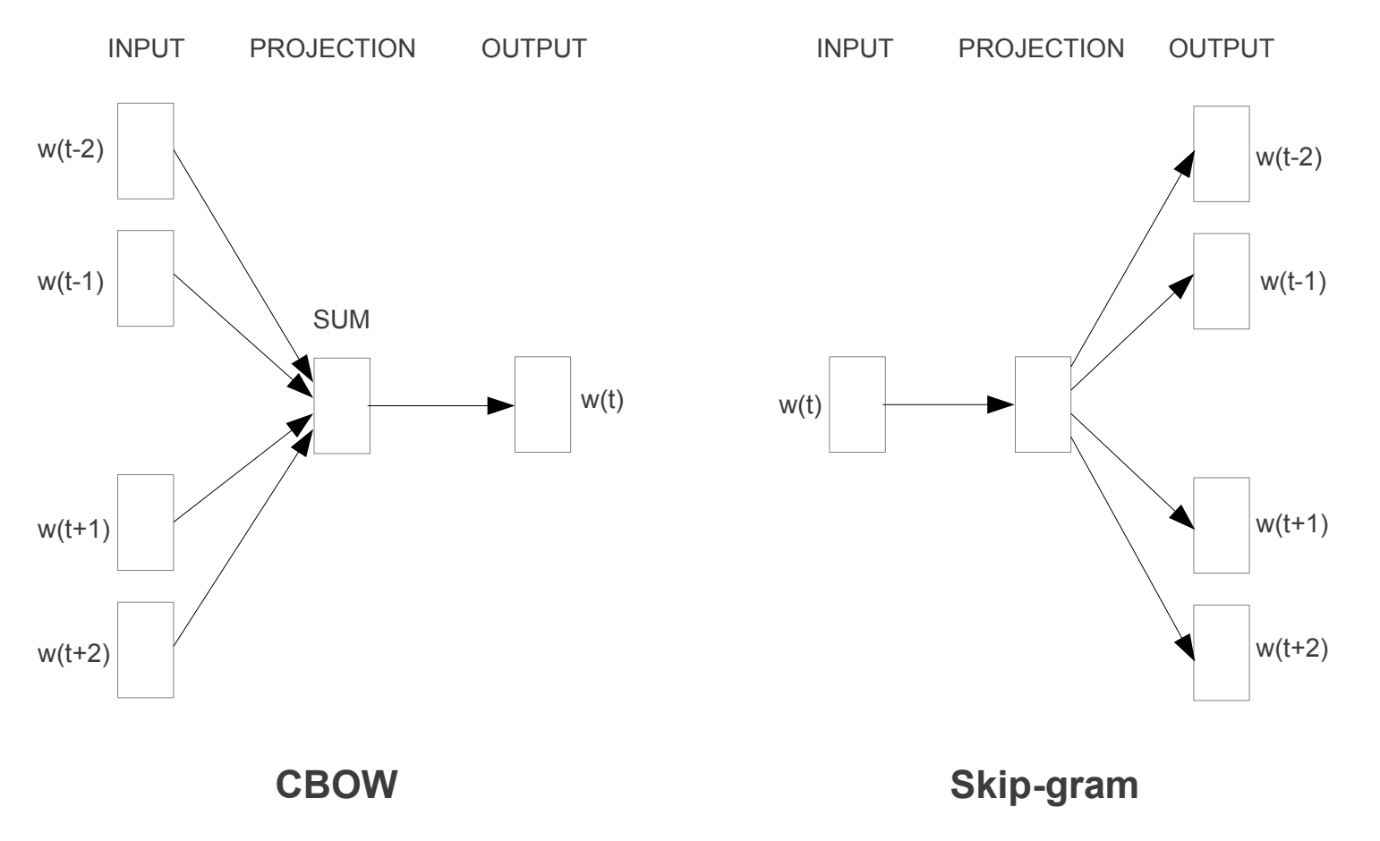
Word Embedding Process

Slide 6
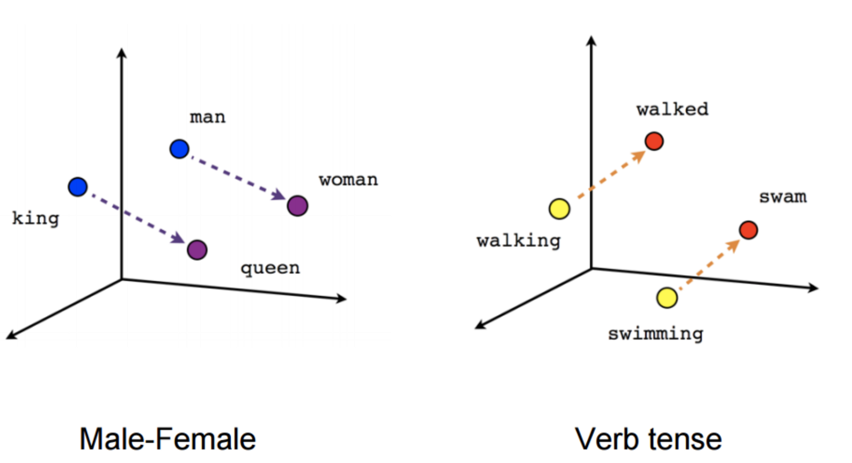
Output of word embeddings

Slide 7
Sample Feed-forward Network
y₁
h₁
x₁
t = 1

Slide 8
Sample RNN
y₃
y₂
h₃
y₁
h₂
x₃
h₁
t = 3
x₂
x₁
t = 2
t = 1

Slide 9
Sample RNN
y₃
y₂
h₃
y₁
h₂
x₃
h₁
t = 3
x₂
h₀
t = 2
x₁
t = 1

Slide 10
The Vanilla RNN Cell
x_{t}
h_{t-1}
W
h_{t}

Slide 11
The Vanilla RNN Forward
C₁
C₂
C₃
y₁
y₂
y₃
x₁ h₀
x₂ h₁
h₁
x₃ h₂
h₂
h₃

Slide 12
The Vanilla RNN Forward
C₁
C₂
C₃
y₁
y₂
y₃
x₁ h₀
x₂ h₁
h₁
x₃ h₂
h₂
h₃
indicates shared weights

Slide 13
Recurrent Neural Networks (RNNs)
Note that the weights are shared over time
Essentially, copies of the RNN cell are made over time (unrolling/unfolding), with different inputs at different time steps

Slide 14
Sentiment Classification
Classify a restaurant review from Yelp! OR Mentors feedback OR … as positive or negative
Inputs: Multiple words, one or more sentences
Outputs: Positive / Negative classification
“The Student is improving”
“He has financial problem”

Slide 15
Sentiment Classification
RNN
h₁
The

Slide 16
Sentiment Classification
RNN
RNN
h₁
h₂
The
Student

Slide 17
Sentiment Classification
h_{n}
RNN
RNN
RNN
h₁
h₂
h_{n-1}
The
Student
good

Slide 18


Sentiment Classification
Linear Classifier
h_{n}
RNN
RNN
RNN
h₁
h₂
h_{n-1}
The
Student
good

Slide 19
Sentiment Classification
Ignore
Ignore
Linear Classifier
h₁
h₂
h_{n}
RNN
RNN
RNN
h₁
h₂
h_{n-1}
The
Student
good

Slide 20
Sentiment Classification
h = Sum(…)
h₁
h_{n}
h₂
RNN
RNN
RNN
h₁
h₂
h_{n-1}
The
Student
good
http://deeplearning.net/tutorial/lstm.html

Slide 21
Sentiment Classification
Linear Classifier
h = Sum(…)
h₁
h_{n}
h₂
RNN
RNN
RNN
h₁
h₂
h_{n-1}
The
Student
good
http://deeplearning.net/tutorial/lstm.html

Slide 22


Drawbacks of RNN
The vanishing/exploding gradient problem
Example - Jane walked into the room. John walked in too. It was late in the day. Jane said hi to
RNNs aren't good in long term dependencies.

Slide 23
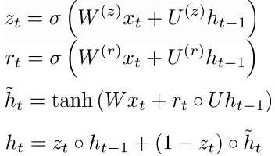
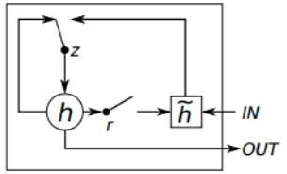
Gated Recurrent Units (GRU)
Update gate
Reset gate
New memory content
Final memory at time step combines current and previous time steps:

Slide 24
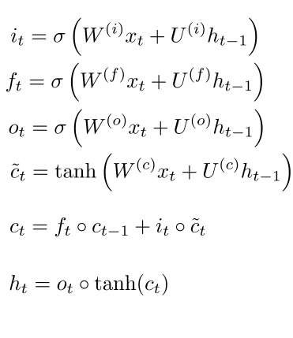
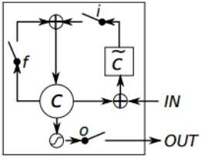
Long Short Term Memory (LSTM)
Input gate (current cell matters)
Forget (gate 0, forget past)
Output (how much cell is exposed)
New memory cell
Final memory cell
Final hidden state

Slide 25
Thank you!!
Sheikh Md. Faysal
Data Scientist at DSL

